Slide 1
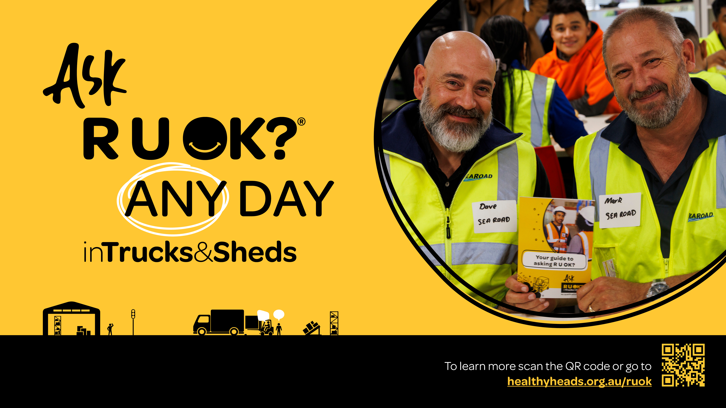
Notes:
Introduce yourself with some background about who you are, why you are presenting and why you are supporting R U OK? in Trucks & Sheds.

Slide 2

Notes:
Acknowledgement of Country
I acknowledge the land on which we are meeting today and pay my respect to elders past, present and future. I acknowledge the diversity of First Nations peoples and cultures, their ongoing connection to country and the strength garnered through such connections.
We/I hope that an R U OK? Conversation releases a spark to ignite someone’s spirit, and creates an exchange that shows we are Stronger Together.

Slide 3
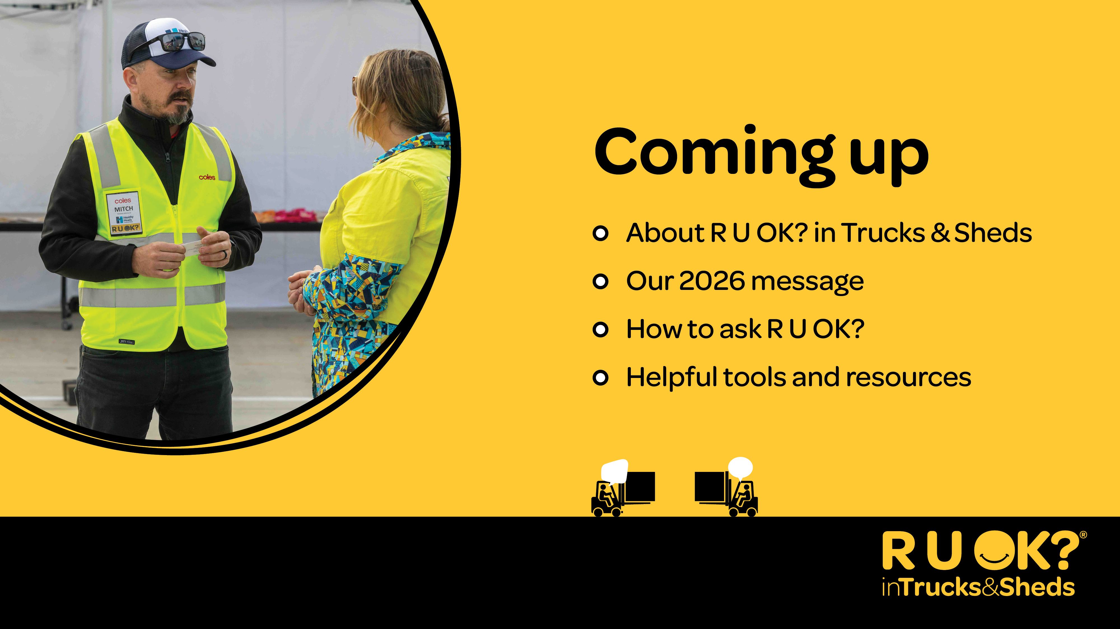
Notes:
Today I’m going to share with you:
A bit about the R U OK? in Trucks & Sheds initiative
The 2026 message – Ask R U OK? Any day in Trucks & Sheds
The 4 steps of how to have an R U OK? Conversation and
Helpful tools and resources that you can use

Slide 4
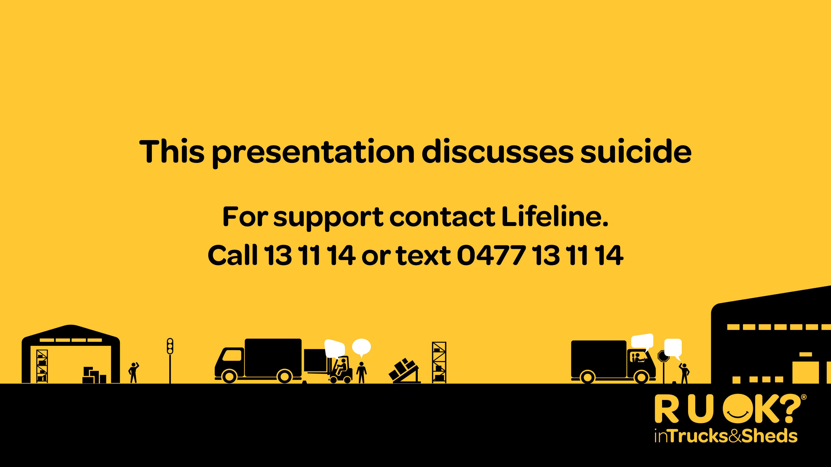
Notes:
Sometimes talking about mental health and wellbeing can bring up tough emotions. If today’s talk brings anything up for you or perhaps today just isn’t the day for you to hear this presentation, it’s OK to excuse yourself.
If you need some extra support, I strongly encourage you to open up to someone you trust, connect with a trusted health professional, or access a support service like Lifeline which is available 24/7 on 13 11 14.
You could add information about how to access your Employee Assistance Program (EAP), if available, or other supports that your organisation offers.

Slide 5

Notes:
Healthy Heads in Trucks & Sheds is a registered not-for-profit Foundation that provides a national approach to improving mental health and physical wellbeing for people working in road transport, warehousing and logistics.
R U OK? is a national suicide prevention charity and registered public health promotion that encourages people to stay connected and have regular, meaningful conversations that can help others through difficult times.

Slide 6

Notes:
For the fifth year, these two organisations have come together to empower people in these industries to meaningfully connect and genuinely ask R U OK? in Trucks & Sheds.
R U OK? in Trucks & Sheds is an industry-wide initiative that encourages individuals and organisations to come together, connect, share stories and learn how to have regular R U OK? Conversations.
But of course, any day is the day to ask R U OK? because regular and meaningful conversations help us get to know the routines and behaviours of our workmates, which can help us spot the signs that they might not be OK.
This is what you are a part of – an initiative empowering people to build a workplace culture that makes people feel more connected and more supported. That we can all be proud of. Thank you for your support so far.

Slide 7

Notes:
This year’s theme is Ask R U OK? Any Day in Trucks & Sheds.

Slide 8
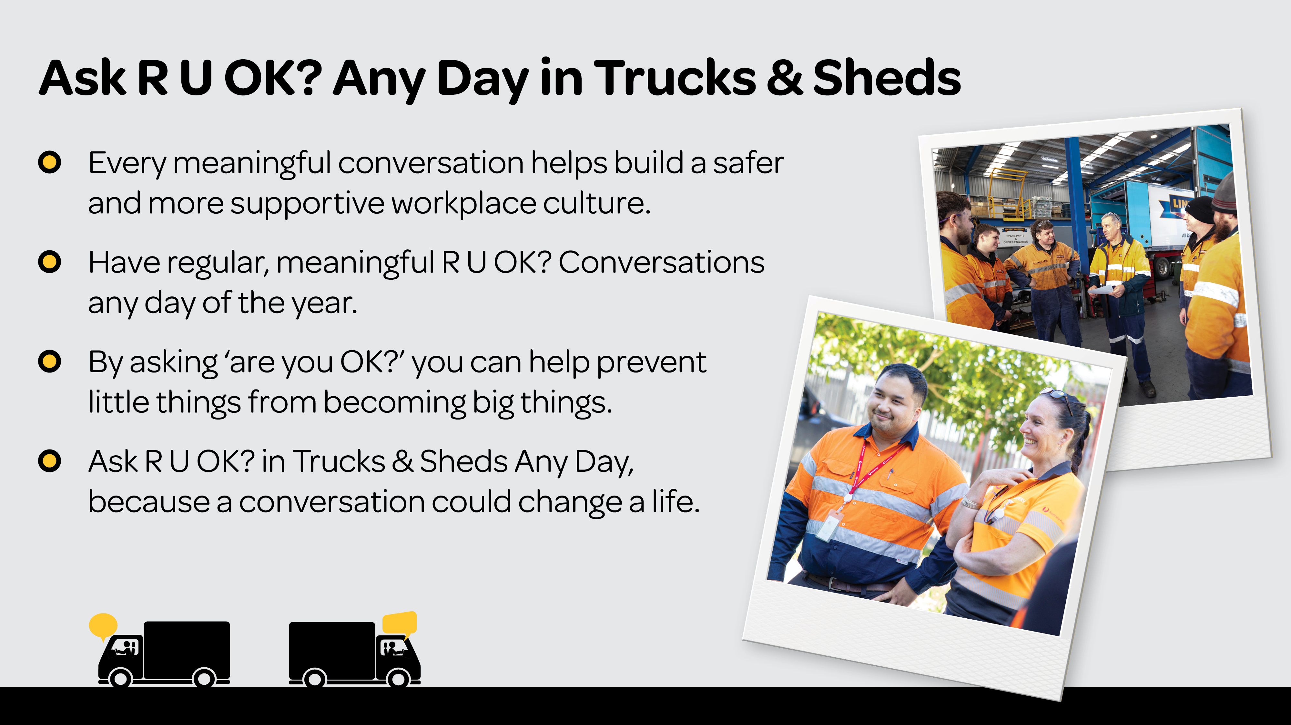
Notes:
Research has shown that those working in the road transport, warehousing, and logistics industries report some of the lowest levels of workplace mental health in Australia.1
R U OK? research has found 90% of people who are regularly asked R U OK? feel more supported, connected and cared about. 2
That’s why we all need to Ask R U OK? Any Day of the year.
Every meaningful conversation helps build a safer and more supportive culture.
Ask R U OK? Any Day in Trucks & Sheds, because a conversation could change a life.

Slide 9
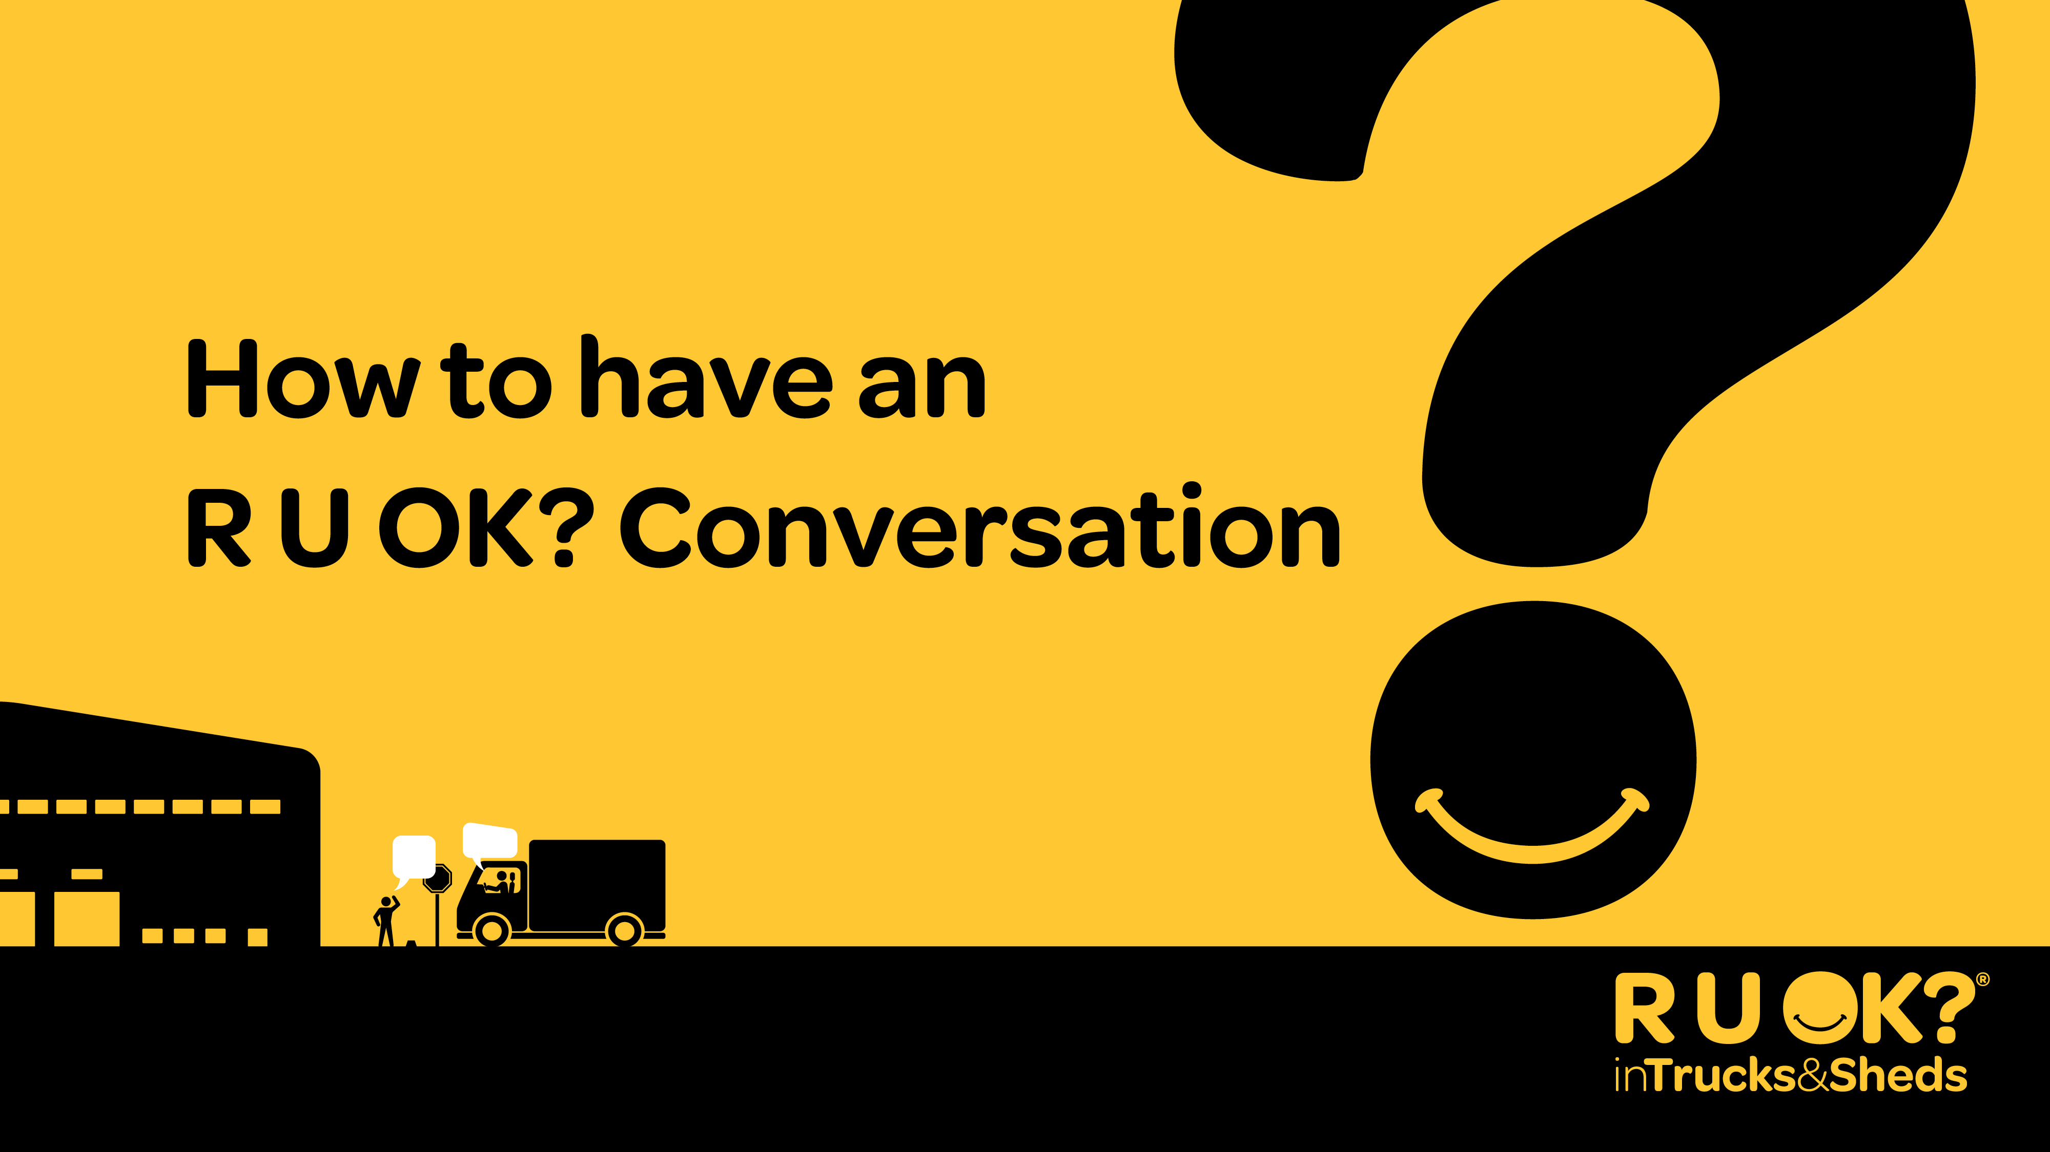
Notes:
I’ll now be sharing some practical tools and tips on how to have an R U OK? Conversation.
The idea is for you to build your confidence to have a conversation with someone you think might be struggling with life’s ups and downs.

Slide 10

Notes:
To know who to ask, you can keep a look out for the signs that someone isn’t themselves.
You might notice changes in what they’re saying or doing, or things that are happening in their life, like relationship breakdown, cost of living pressures, or grief and loss, amongst other things.
When you notice these signs, it’s time to ask.
Question for the audience:
What are some signs that might indicate someone needs support?
Possible answers:
– They are missing or late to shifts
– They are not sitting in the lunch room as they usually would
– They might seem angry or easily irritated
– They might be withdrawn or switched off
– They might get dismissive or defensive
– They seem exhausted
– They are having trouble concentrating
– They might be expressing that they feel like a burden or are concerned about the future

Slide 11
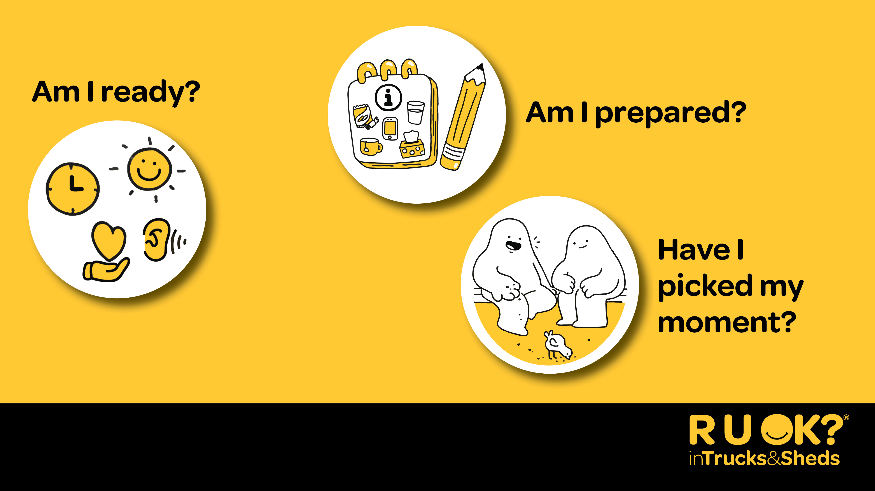
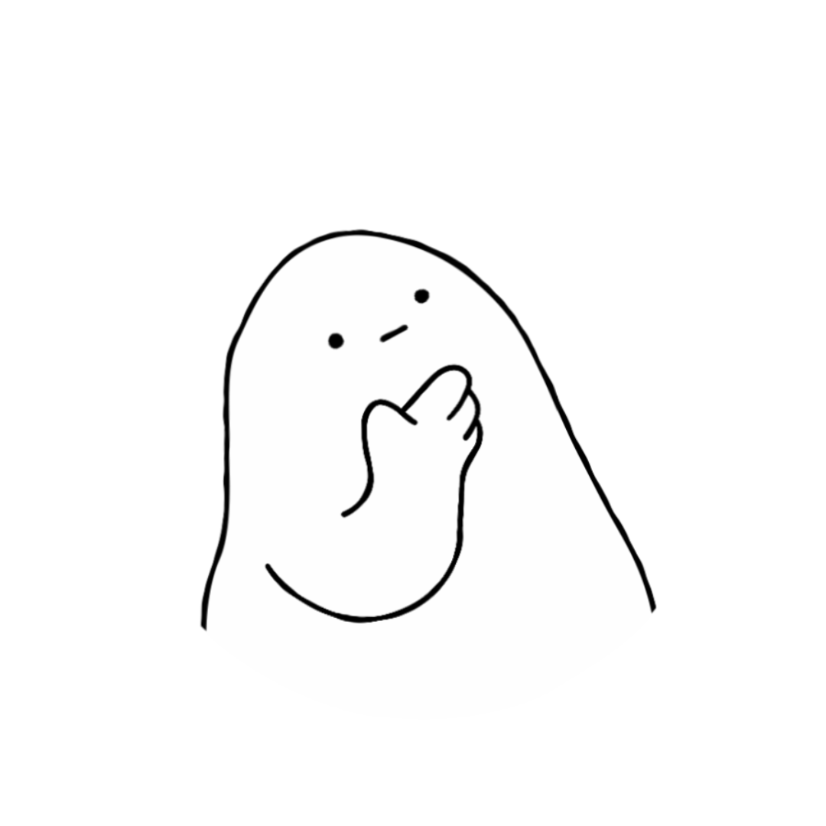
Notes:
Before you can support someone else, you need to look after yourself. And that’s OK. You might not be in the right headspace or maybe you’re not the best person for the conversation. If that’s the case try to think of someone else in their support network who could talk to them.
To help you decide whether you’re ready to start a meaningful conversation, ask yourself:
Am I ready? – Am I in a good headspace and ready to genuinely listen?
Am I prepared? – Have I reminded myself that it’s OK to not have all the answers? Am I prepared for a possible emotional reaction?
Have I picked my moment? – Have I chosen somewhere private? Have you picked a convenient time for you both? If they say they don’t have time, you can arrange for another time.

Slide 12
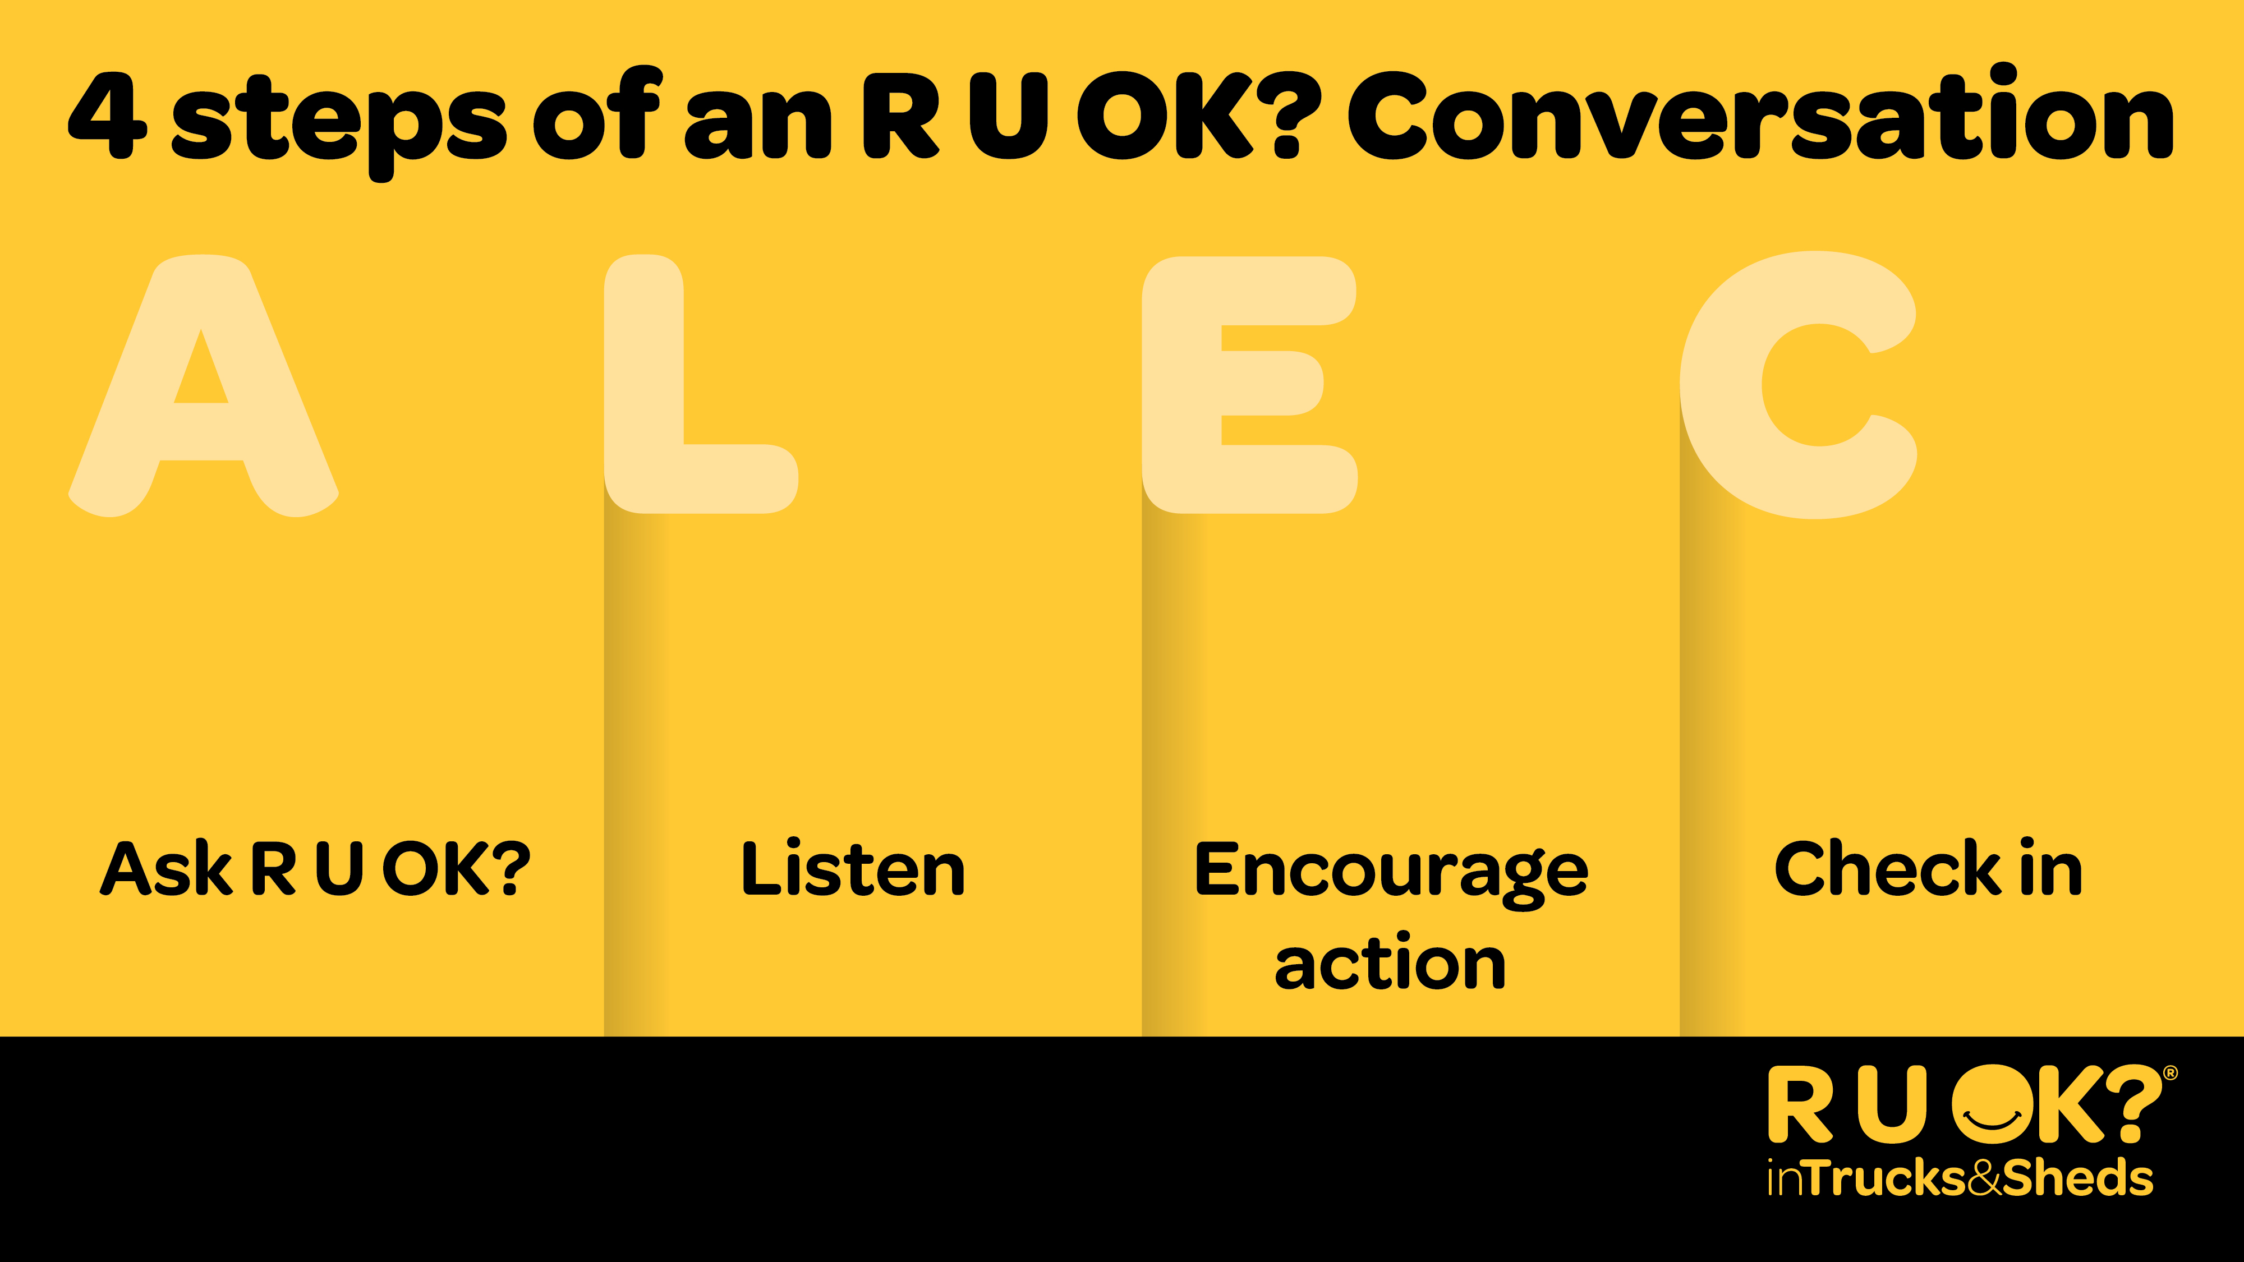
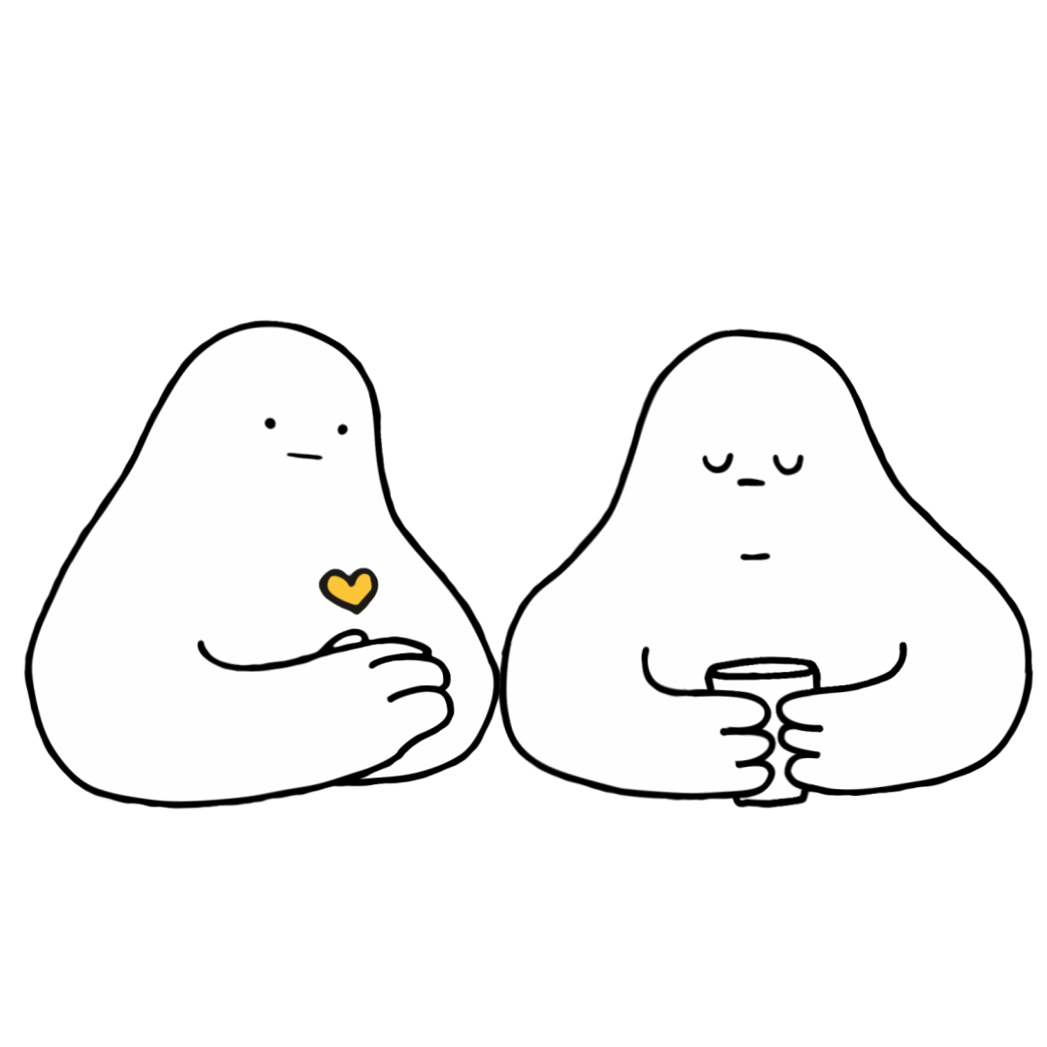
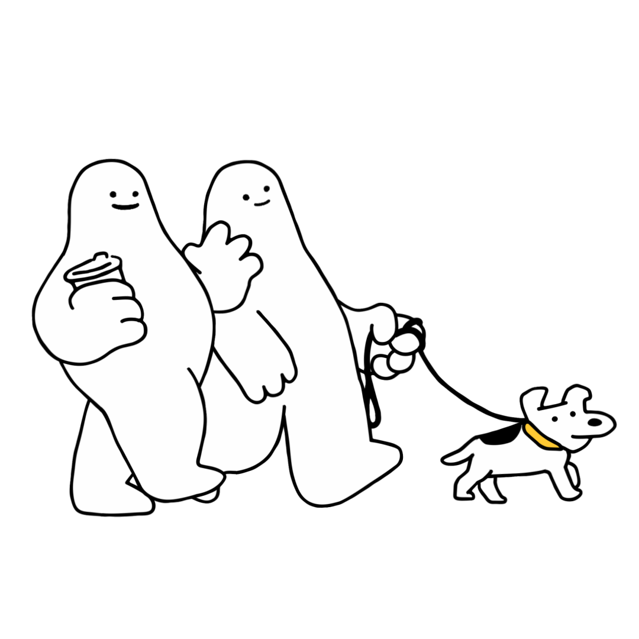
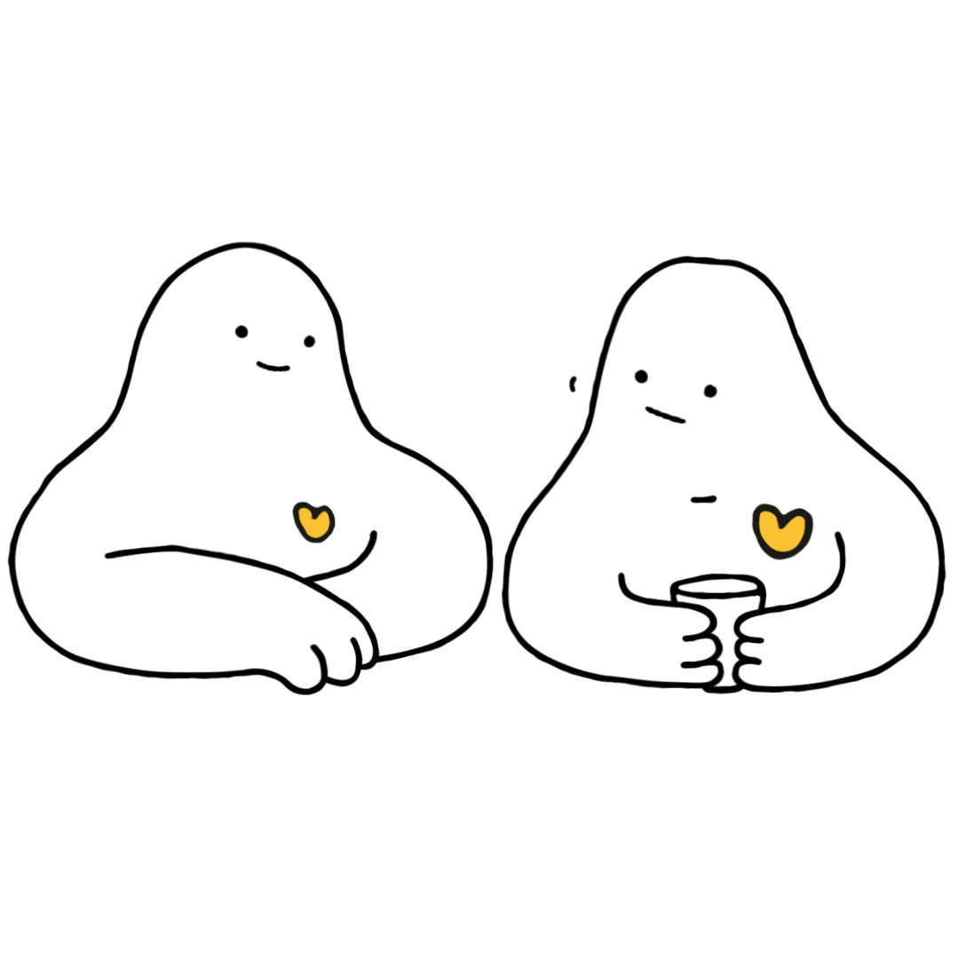
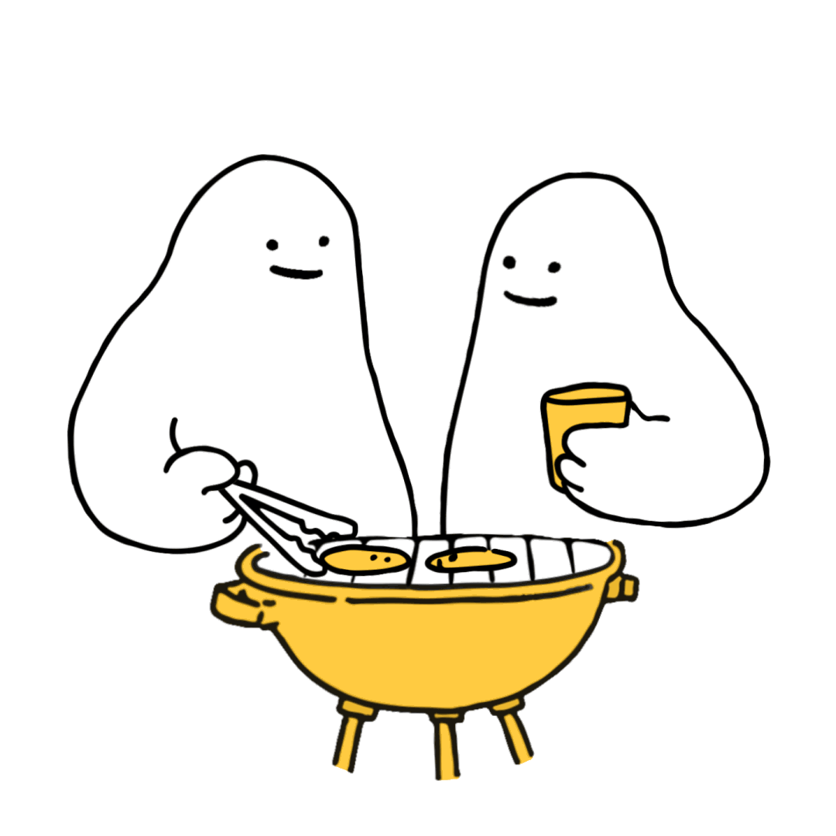
Notes:
When you’ve noticed the signs and decided that you’re ready, these are the 4 steps of an R U OK? Conversation:
Ask R U OK?
Listen
Encourage Action
Check in
There’s a handy acronym of ‘ALEC’ to help you remember.

Slide 13
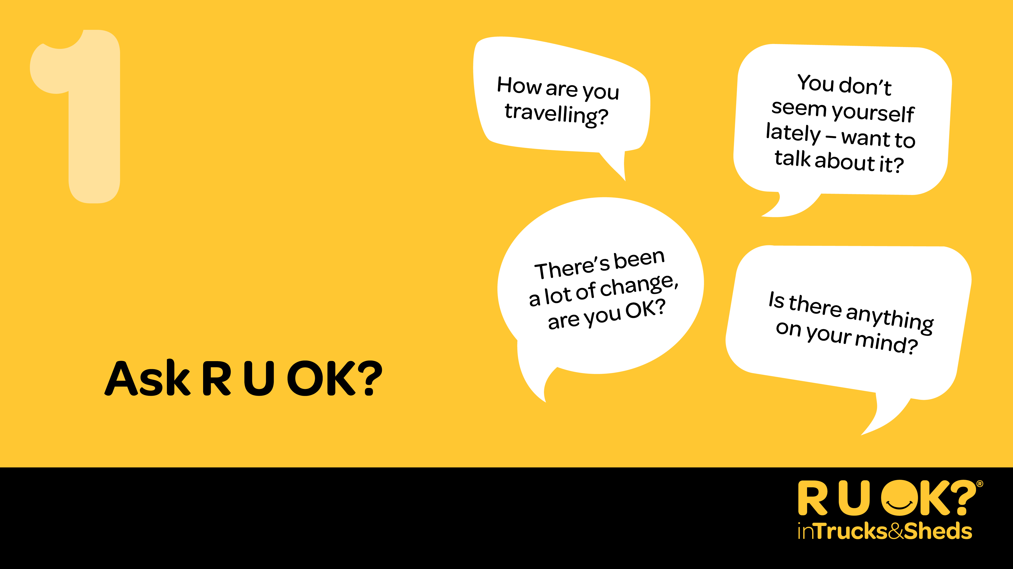
Notes:
Step 1: Ask
Be relaxed and friendly in your approach. Think about how you can ease into the conversation.
You don’t need to use the words, ‘are you OK?’ – you can ask in any way that feels comfortable for you and your relationship with that person.
If they don’t want to talk let them know you’ll always be ready for them when they are or ask if there’s someone else they’d be more comfortable chatting to.
You can start by letting them know you’ve noticed a change, without being accusatory. You could say something like:
“I’ve noticed a few changes in what you’ve been saying/doing. How are things for you at the moment?”
“I know there’s been some big life changes for you recently, how are you going with that?”
OR
“You don’t seem yourself lately – want to talk about it?”

Slide 14
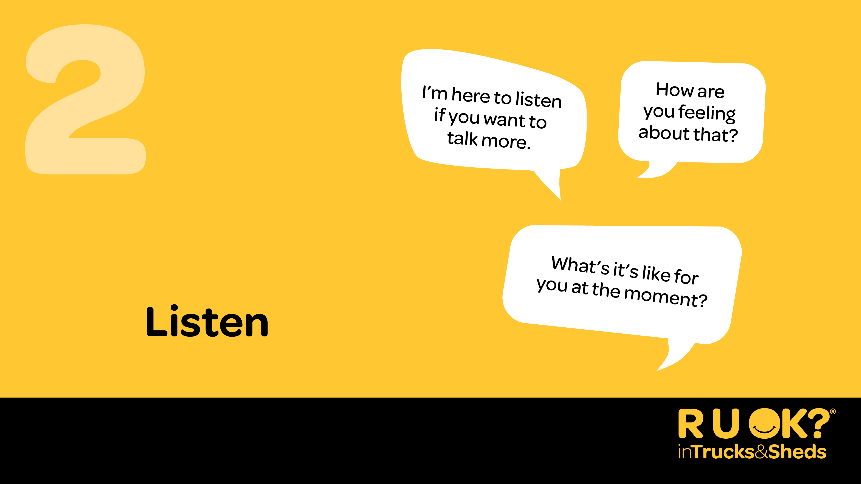
Notes:
Step 2: Listen
Listening with an open mind can be the hardest thing to do, but it’s one of the most important parts of the conversation.
It can be tempting to jump in and try to push someone’s worries away or offer a ‘quick fix’. It can be really hard to hear that someone is in pain or struggling – but try and sit with the discomfort and remind yourself that your support can be crucial.
Avoid rushing the conversation and don’t be afraid to sit in silence.
Give the person some space and quiet so they can find the words to express what they’re going through.
You could say:
“I’m here to listen if you want to talk more”
“How are you feeling about that?”
OR
“I’m not going to pretend I know what it’s like for you, but I’m here to listen to why you feel the way you do.”

Slide 15
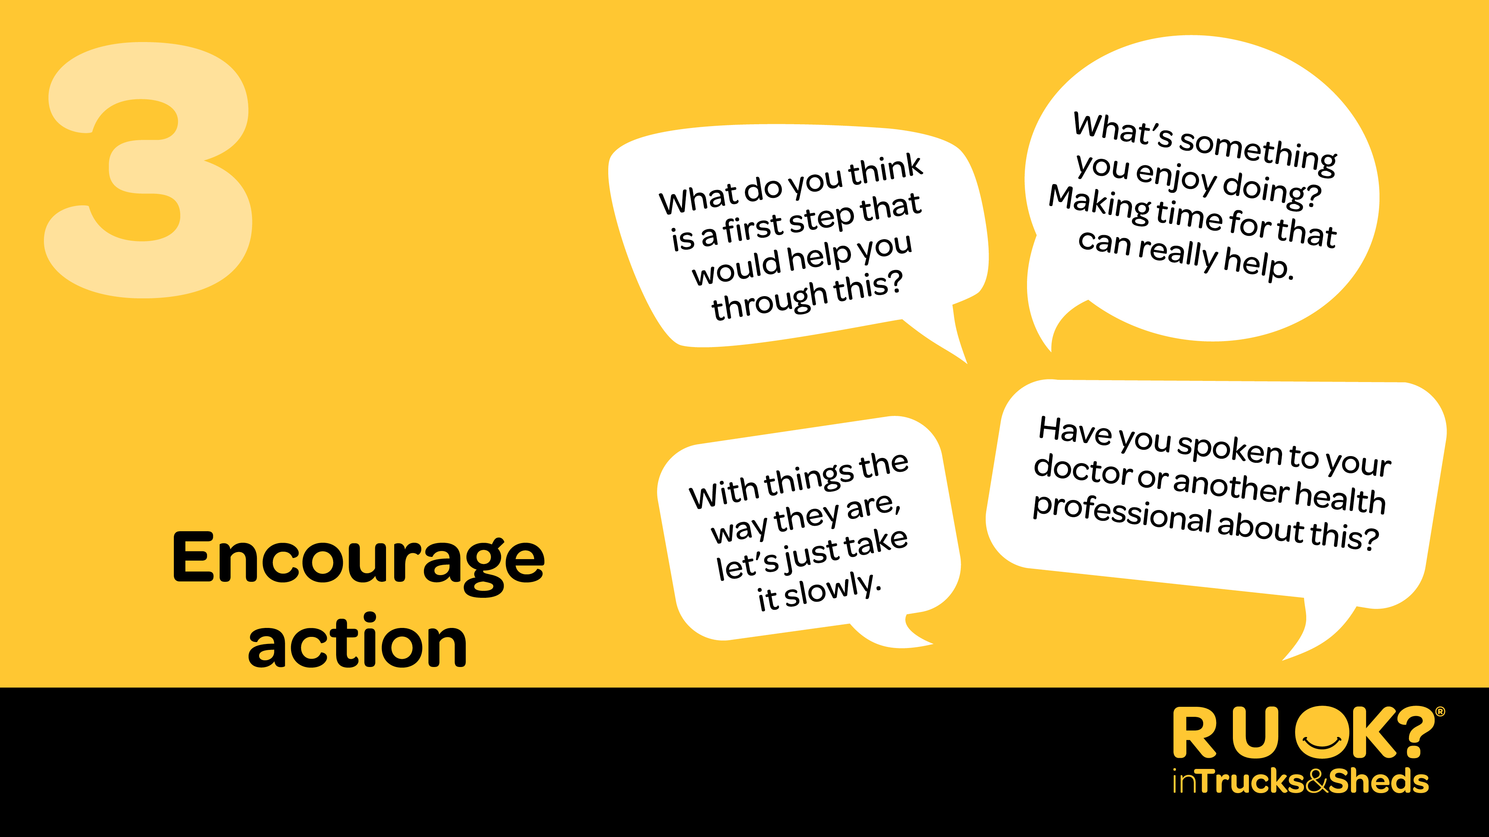
Notes:
Step 3: Encourage action
Once they’ve shared what they’re going through, you might suggest to them that they think about one small step they might be able to take to improve their situation.
If they’ve been feeling this way for more than two weeks they might need to see their doctor or an appropriate health professional.
You don’t have to have the answers or be able to offer professional health advice, but you can help them consider the next steps and actions they can take to manage their situation.
You could say:
“What do you think is a first step that would help you through this?”
“What can I do right now to support you?”
OR
“Have you spoken to your doctor or a health professional about this? It might be a matter of finding the right fit with someone.”

Slide 16
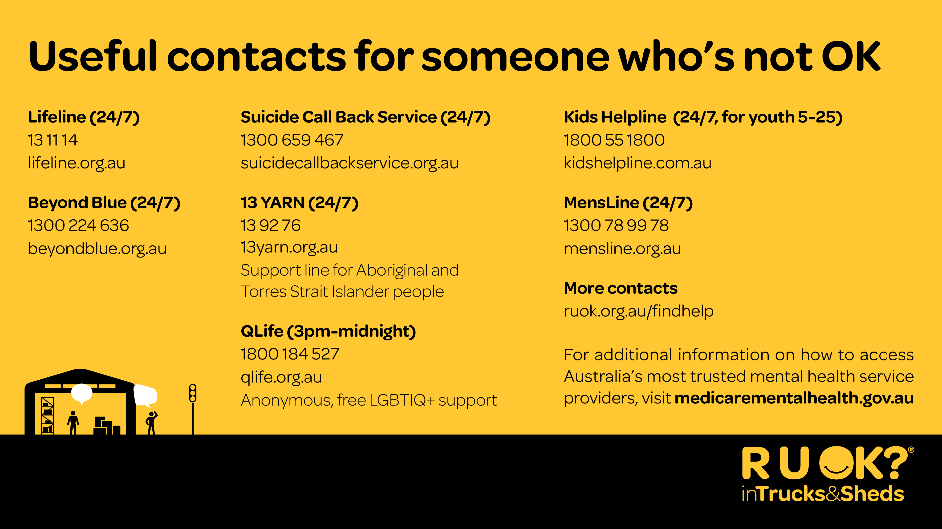
Notes:
Sometimes that person might need immediate support. These are some useful contacts for Australian services that are available nationally and can provide emotional and crisis support.
If at any time you feel overwhelmed by any feelings, it is important that you talk to someone you trust. A doctor, family member or friend, or make contact with one of these services.
These services can also provide you with guidance to support someone else.
You can find a directory with more services and supports on the R U OK? website (ruok.org.au) and the Healthy Heads App and website (www.healthyheads.org.au).
If your workplace has an Employee Assistance Program (EAP) this is a good opportunity to remind them how to access it or you could also suggest downloading the free Healthy Heads App.

Slide 17
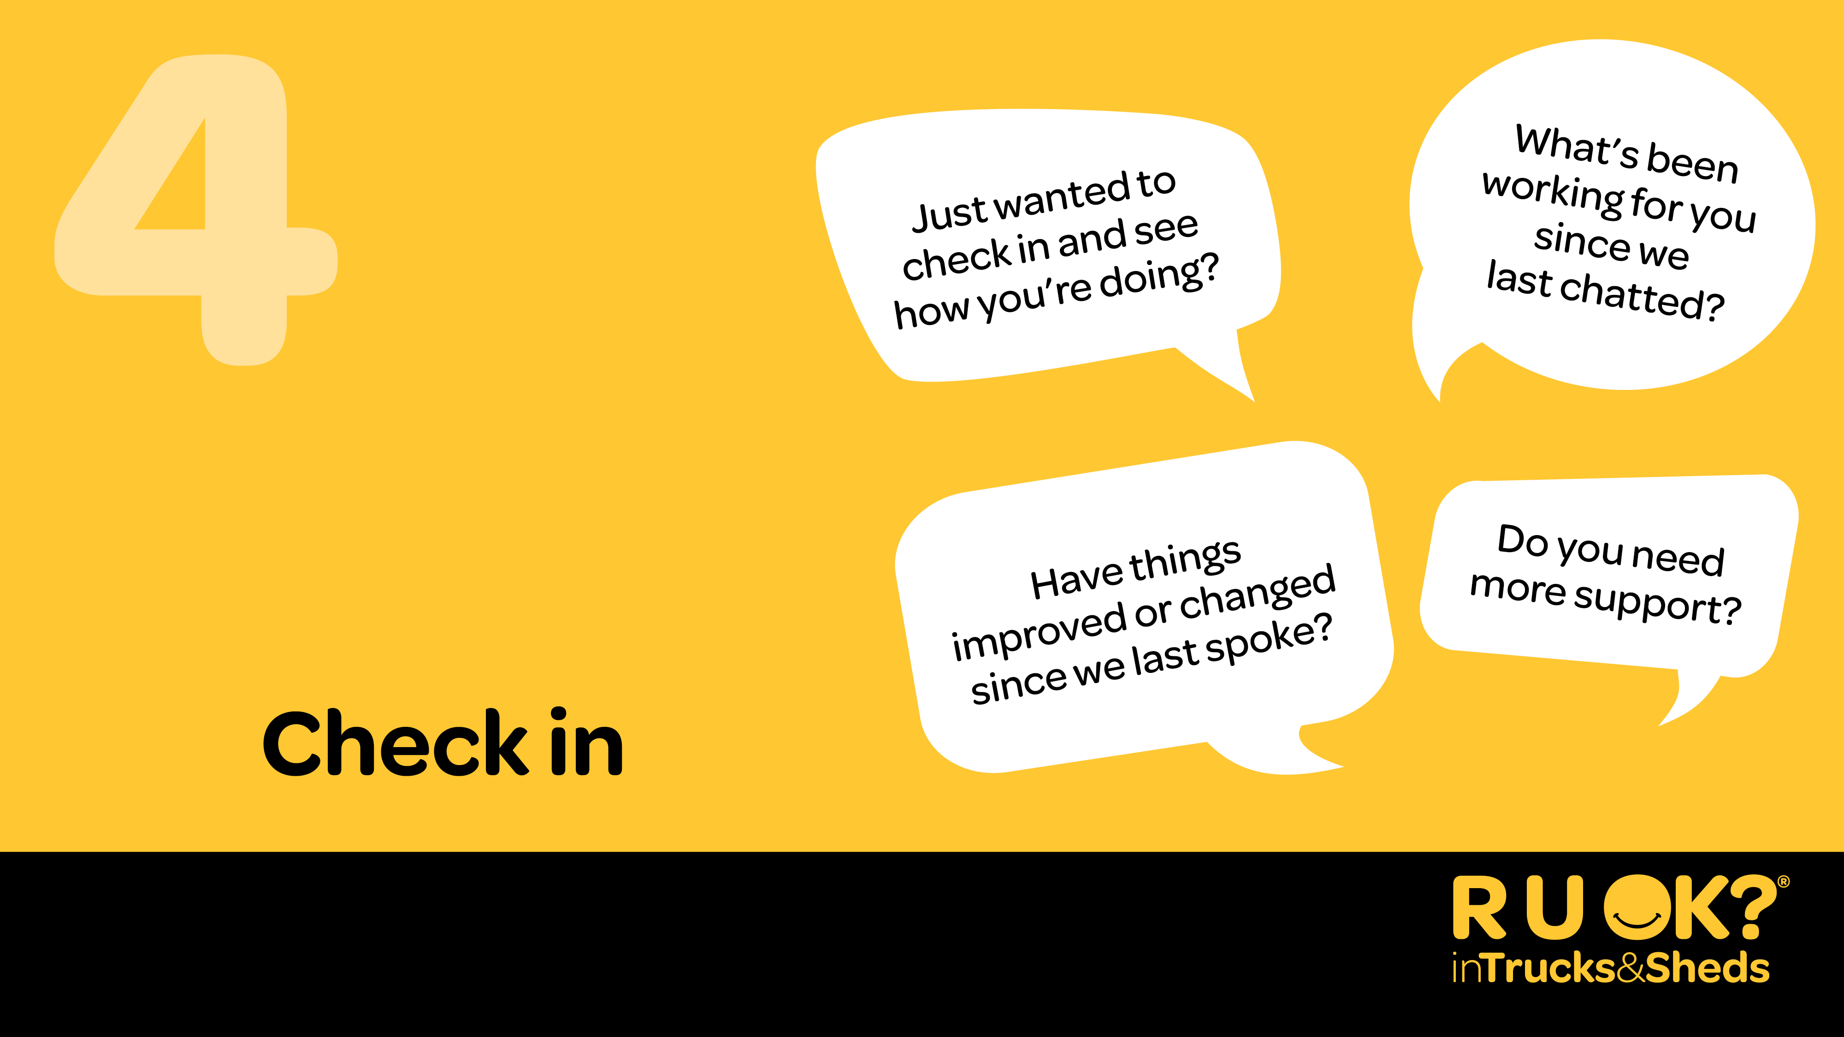
Notes:
Step 4: Check in
After the conversation make sure you stay connected and keep checking in.
Make a joint decision to spend some time together in the near future so you can see how they’re going. Your ongoing care can make a difference and make them feel supported.
When you check in you could say:
“Just wanted to check in and see how you’re doing?”
“Have things improved or changed since we last spoke?”
OR
“Do you need more support?”
It’s important that if you say you will follow up or check in, you do.

Slide 18
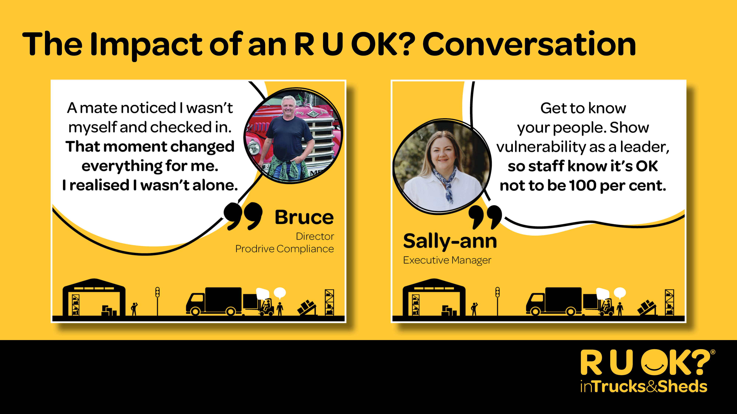
Notes:
Those are the 4- steps of an R U OK? Conversation.
1. Ask
2. Listen
3. Encourage Action
4. Check In.
To help show you the power of a conversation, Bruce and Sally-ann from within the industry have shared their lived experience of suicide and the impact of an R U OK? Conversation and why it’s so important to build an R U OK? Culture in Trucks & Sheds.
You can read more about their stories at healthyheads.org.au/ruok

Slide 19
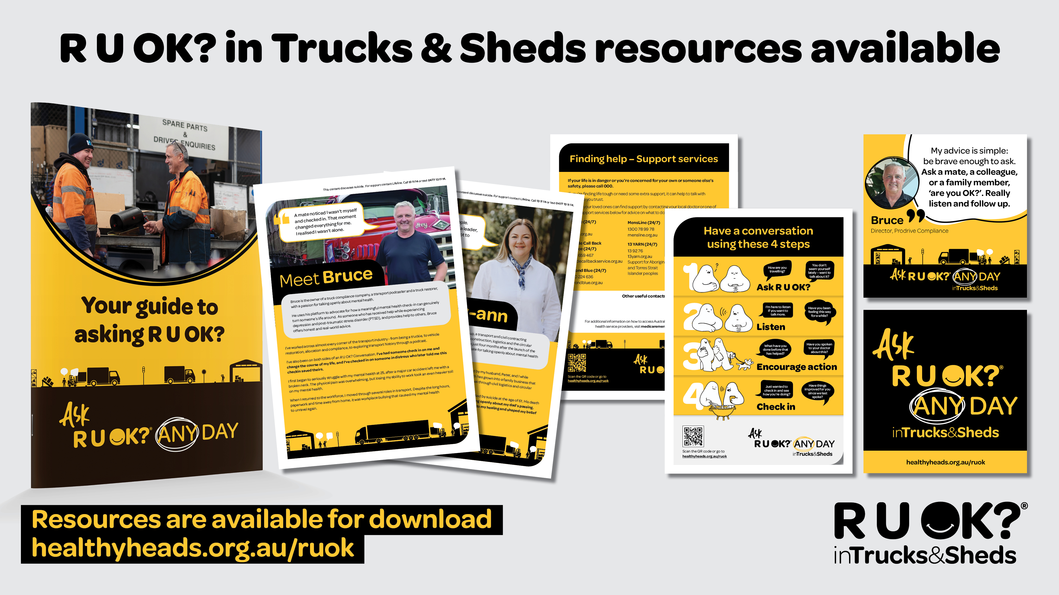
Notes:
For additional resources to help build an R U OK? Culture in Trucks & Sheds, there are a number of free resources available at healthyheads.org.au/ruok

Slide 20

Notes:
Remember to Ask R U OK? Any Day in Trucks & Sheds, because a conversation could change a life.
So before you leave today, take a moment to think about those in your world – at home, at work, in your community. Who will you ask?
Thank everyone for coming and take any questions if you have time.
If you don’t know the answer to a question asked, let them know that you will find out and come back to them with the answer.
To learn more or access resources go to healthyheads.org.au/ruok

Slide 21

Notes:
We have included an extra blank slide, if you wish it edit the powerpoint.

Slide 22

Notes:
We have included an extra blank slide, if you wish it edit the powerpoint.

Slide 23

Notes:
We have included an extra blank slide, if you wish it edit the powerpoint.

